Slide 1
Secure Data Hiding in Image Using Steganography
CAPSTONE PROJECT
Presented By: ARGHA MAITY
Student Name : ARGHA MAITY
College Name : TECHNO MAIN SALT LAKE
Department : COMPUTER SCIENCE AND ENGINEERING

Slide 2
OUTLINE
Problem Statement
Technology used
Wow factor
End users
Result
Conclusion
Git-hub Link
Future scope

Slide 3
Problem Statement
Traditional encryption secures data but makes it obvious that sensitive information exists, attracting attackers.
There is a need for a method that ensures both security and invisibility for covert communication.
Existing steganographic techniques have limitations in capacity, security, or resistance to detection.
The project aims to develop a secure and efficient image-based steganography method to hide data while
ensuring minimal detectability and high integrity.

Slide 4
Technology used
Programming Language: Python
Libraries & Tools:
OpenCV – For image processing
string – For manipulation of strings
os – For windows functions
Cryptography – For additional security layers
Steganographic Techniques:
LSB (Least Significant Bit) Method – For embedding data into images
Platform: Windows

Slide 5
Wow factors
• Stealth & Security – Data remains hidden and undetectable.
• Lightweight & Fast – Optimized Python implementation.
• High Image Quality – Minimal distortion after embedding.
• Real-World Use – Secure communication & watermarking.

Slide 6
End users
• Government & Military – Secure communication without attracting attention.
• Corporate Sector – Protect sensitive business data.
• Journalists & Whistleblowers – Safely share confidential information.
• Cybersecurity Experts – Use for secure data transmission.
• Individuals – Personal data protection & privacy.

Slide 7
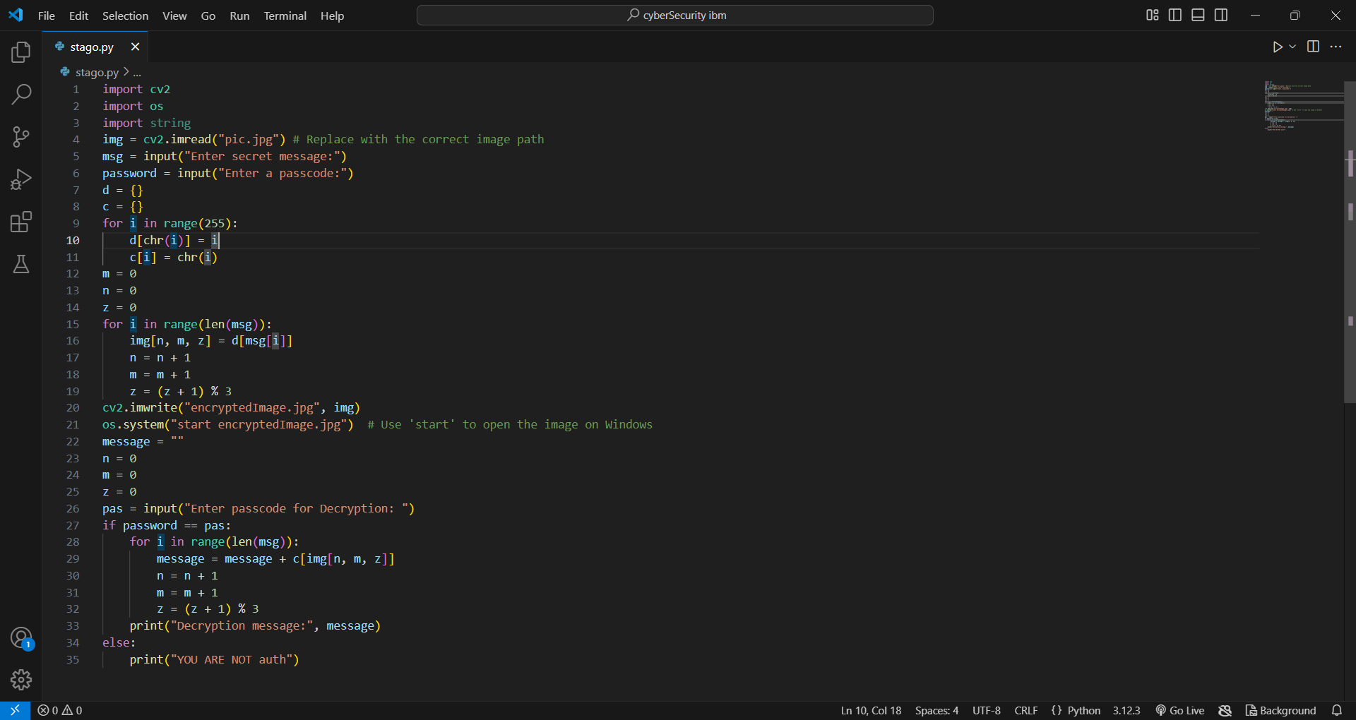
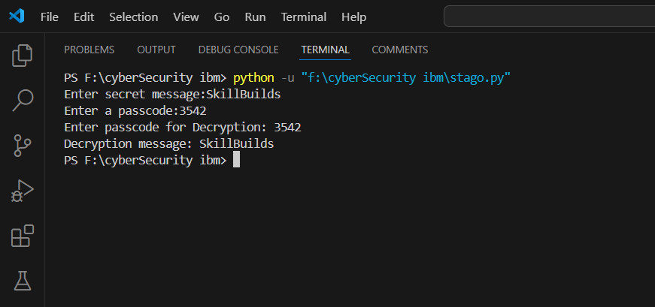

Results

Slide 8
Conclusion
Secure & Covert Data Hiding – Steganography ensures hidden communication without drawing attention.
Efficient & Reliable – Python-based implementation with minimal impact on image quality.
Wide Applications – Useful in cybersecurity, corporate security, and personal privacy.
Future Scope – Can be enhanced with AI, encryption, or support for more file types.

Slide 9
GitHub Link
https://github.com/Argha-maity/AICTE-Project.git

Slide 10
Future scope(optional)
• Enhanced Security – Integrating encryption with steganography for double-layer protection.
• AI-Powered Steganography – Using deep learning to make data embedding more robust and undetectable.
• Support for Multiple File Types – Expanding beyond images to audio, video, and documents.
• Resistance to Steganalysis – Developing methods to evade detection by advanced steganalysis tools.
• Cloud & Network Integration – Implementing secure steganographic communication over cloud and networks.

Slide 11
THANK YOU

